Slide 1
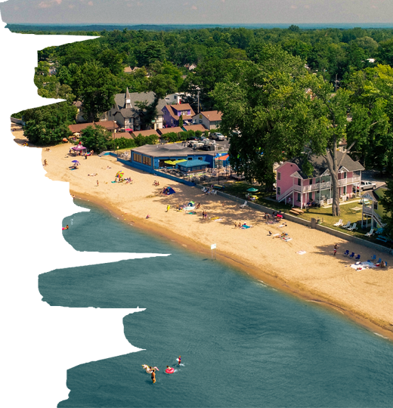
2023 DIGITAL COOPERATIVE MARKETING PROGRAM

Slide 2
WHAT’S IN IT FOR YOU?
Cost Effectiveness
Cooperative Digital Marketing lowers your advertising costs as you are sharing them with Oneida County Tourism.
Exposure
As a partner, you will benefit from Oneida County Tourism’s experience in Digital Marketing, which is attracting new and relevant visitors to the area.
Growth Potential
Use effective channels for your Digital Marketing program and maximize your ROI by building exposure to relevant audiences and extending your reach beyond your current marketing capabilities.
Oneida County Tourism

Slide 3
WHO CAN PARTICIPATE?
Oneida County Tourism is extending the opportunity to participate in the Cooperative Digital Marketing program to Partners who meet at least one or all of the criteria in aiming to grow tourism in Oneida County focusing on:
Experiences Events
Exhibitions
Oneida County Tourism
Oneida County Tourism

Slide 4
DIGITAL COOPERATIVE MARKETING INVESTMENT
Partner Investment
Each Partner’s required investment to participate in the Cooperative Digital Marketing program is:
$2,500
Oneida County Tourism Investment
OCT will match each Partner’s Cooperative Digital Marketing investment dollar for dollar:
$2,500 max match
Oneida County Tourism has reserved match funds for up to 6 partners.
Oneida County Tourism

Slide 5
WHAT SERVICES ARE PROVIDED?
PROGRAM SERVCES | ALL PARTNERS
Marketing Plan & Proposal Outline | ✔️
Plan & Proposal Review with C & D Advertising | ✔️
Google Analytics Setup | ✔️
Digital / Social Set up | ✔️
One (1) Round of Ad Revisions | ✔️
Four (4) months of Ad Management Budget Monitoring & Adjustment, Ad Copy Editing | ✔️
Reputation Management Responding to Questions, Liking Comments, etc | ✔️
One (1) Promoted Blog Post featured On OneidaCountyTourism.com | ✔️
Featured in CrowdRiff Promotional Galleries | ✔️
Final Cooperative Digital Marketing Program Report | ✔️
Partner Investment | $2,500
Oneida County Tourism Investment | $2,500
Total Program Budget | $5,000

Slide 6
TO PARTICIPATE CONTACT
Oneida County Tourism
KELLY BLAZOSKY 315- 724-7221
Kelly@oneidacountytourism.com
Oneida County Tourism

